Slide 1
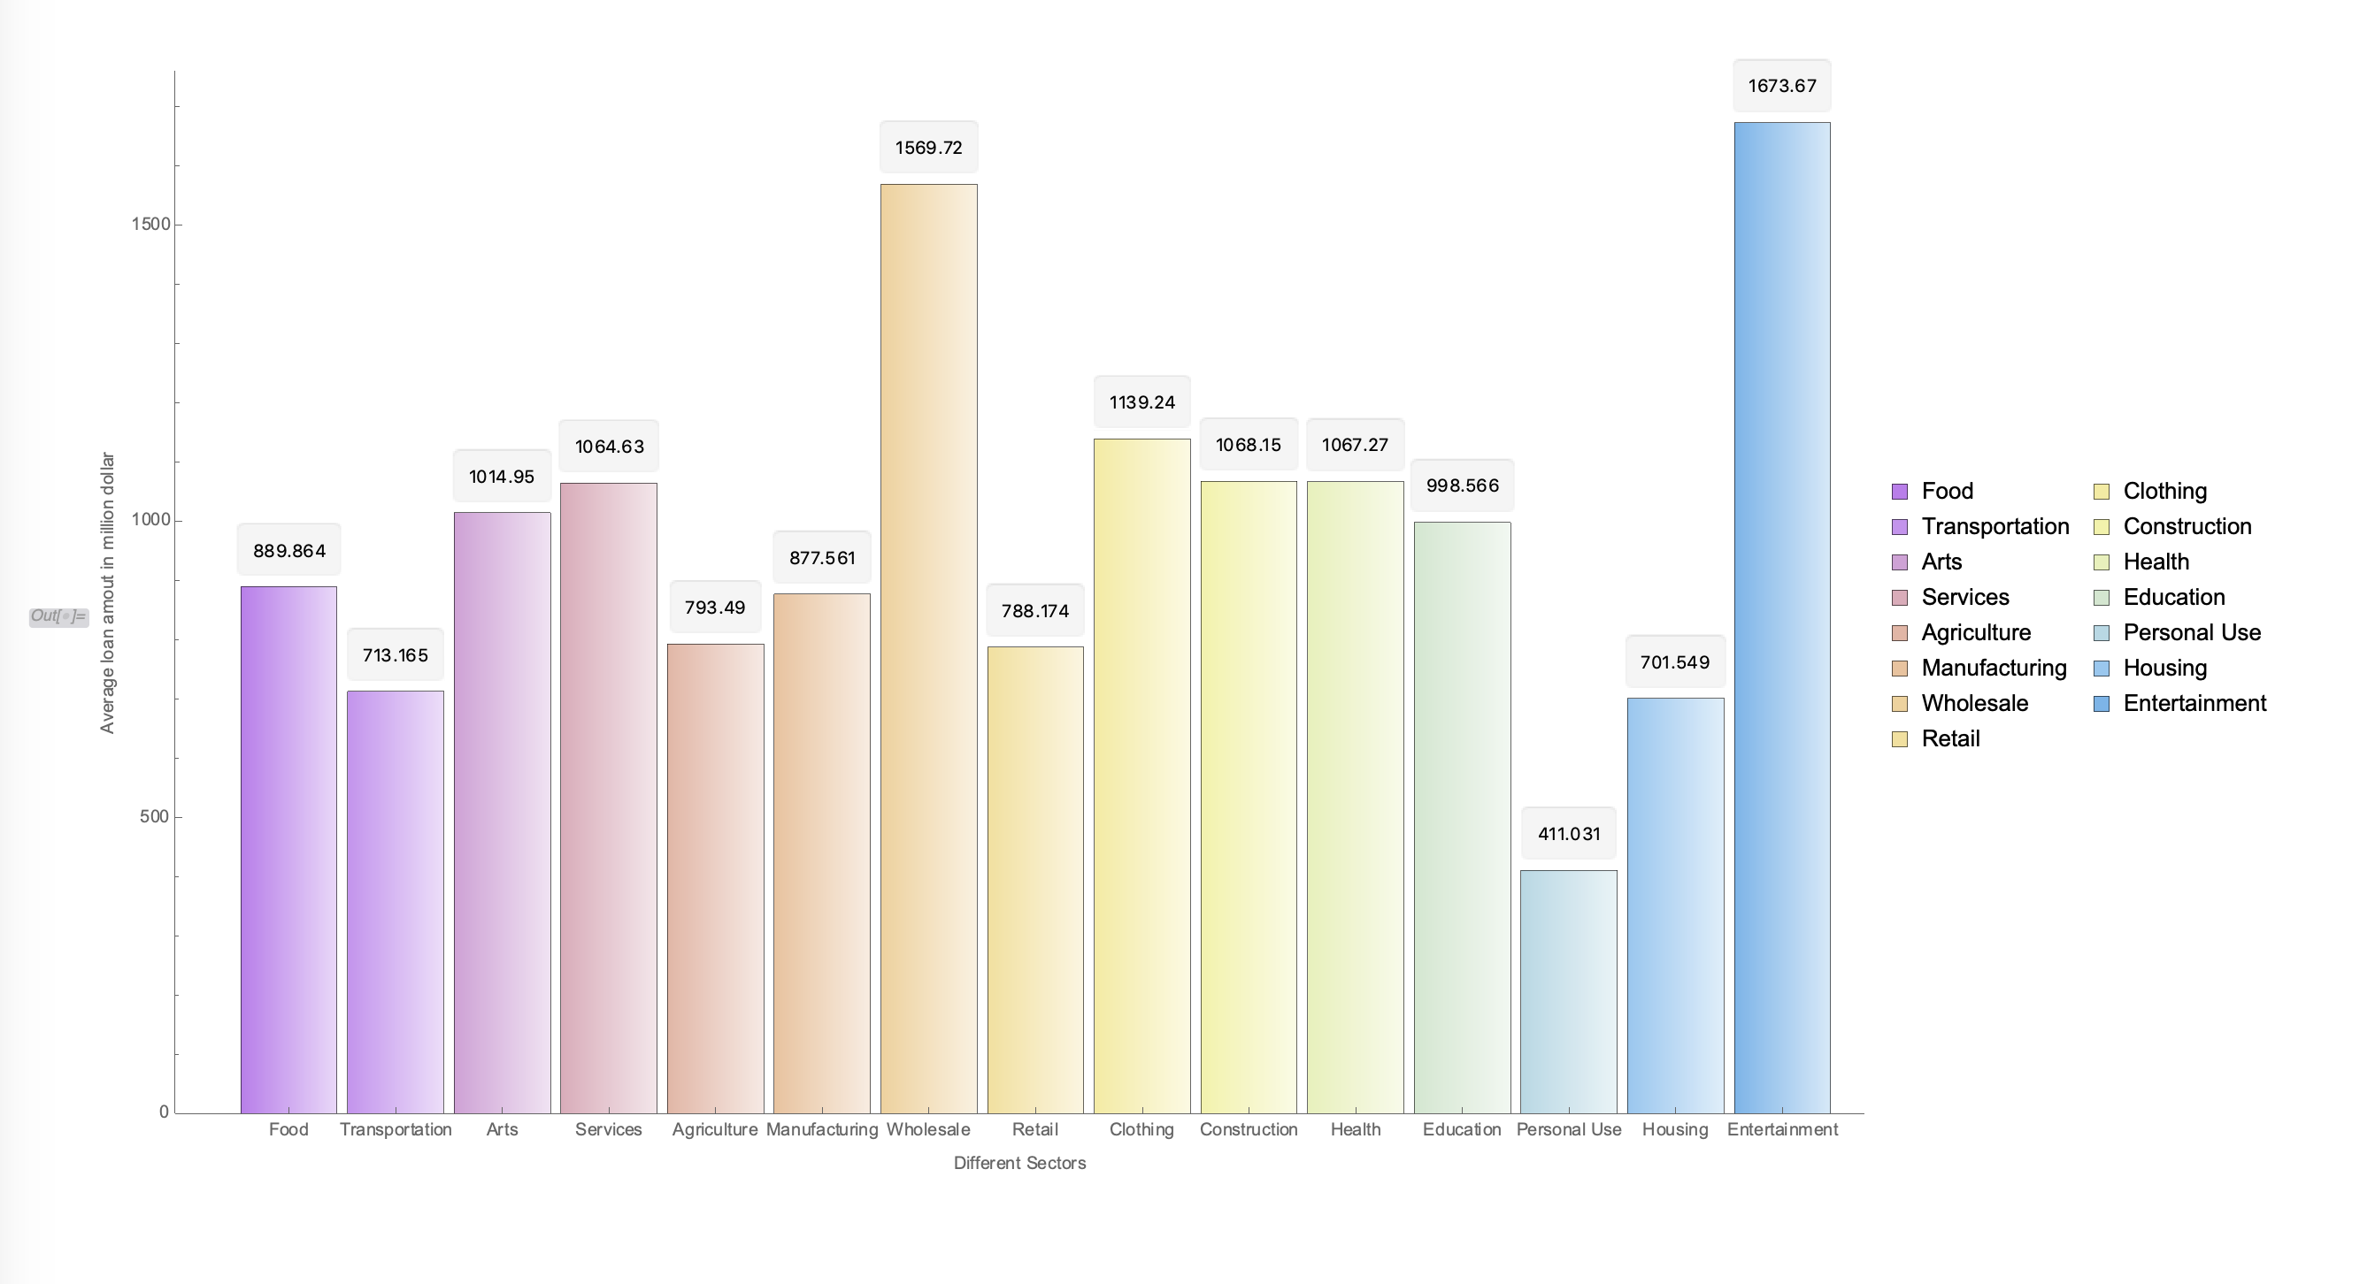
Kiva Crowdfunding Data Analysis and Visualization
Name : Prashanth
Kiva.org is an online crowdfunding platform to extend financial services to poor and financially excluded people around the world.
Dataset

Slide 2
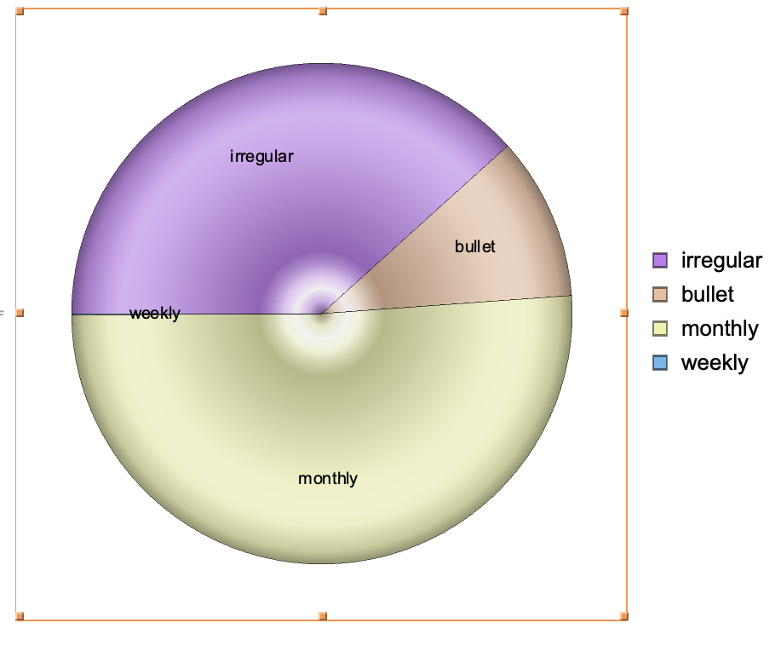
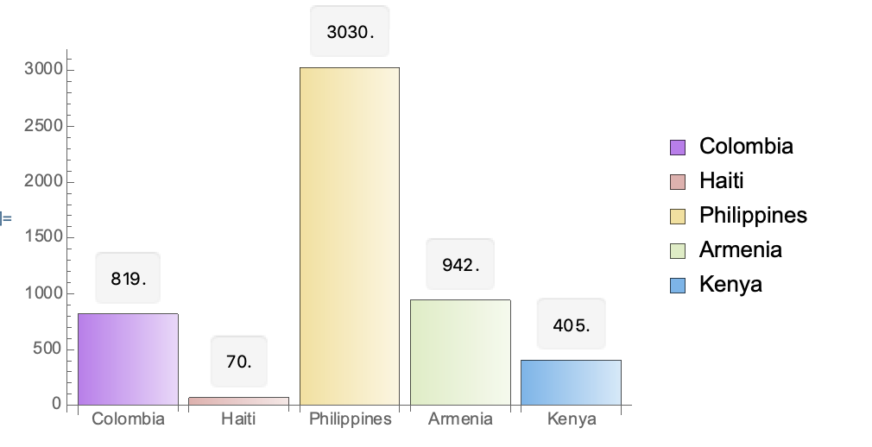
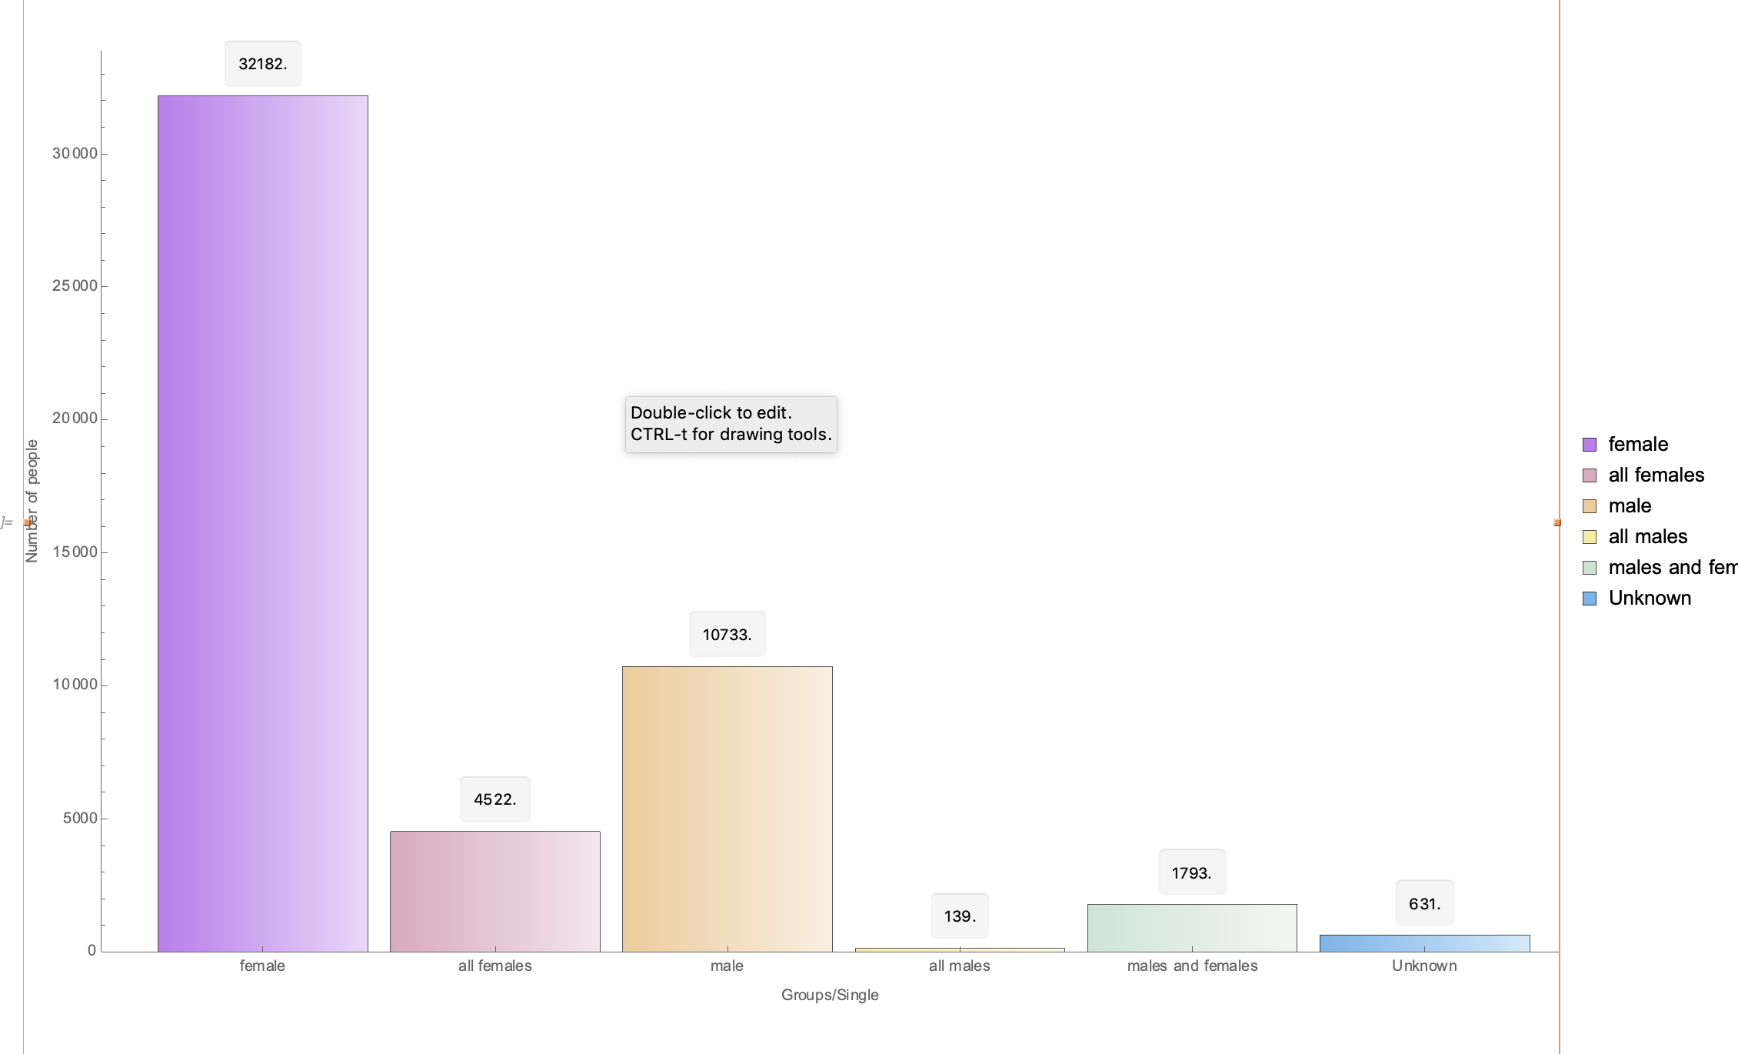
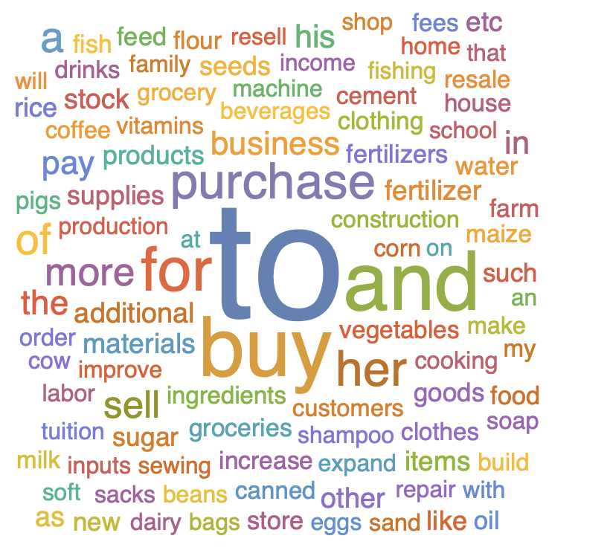
Data Exploration
Data Preparation
Types of repayment intervals :
Top frequent countries who got loans :
Word cloud of reasons for taking loans :
Replacing the missing values.
Removal of duplicate values.
Data Integration
Data Transformation.
Handling outliers and incomplete variables.
Meaningful analysis of few columns
Borrower Genders’ column ({female},{female, female},{female, male, male, female},{male, male})

Slide 3
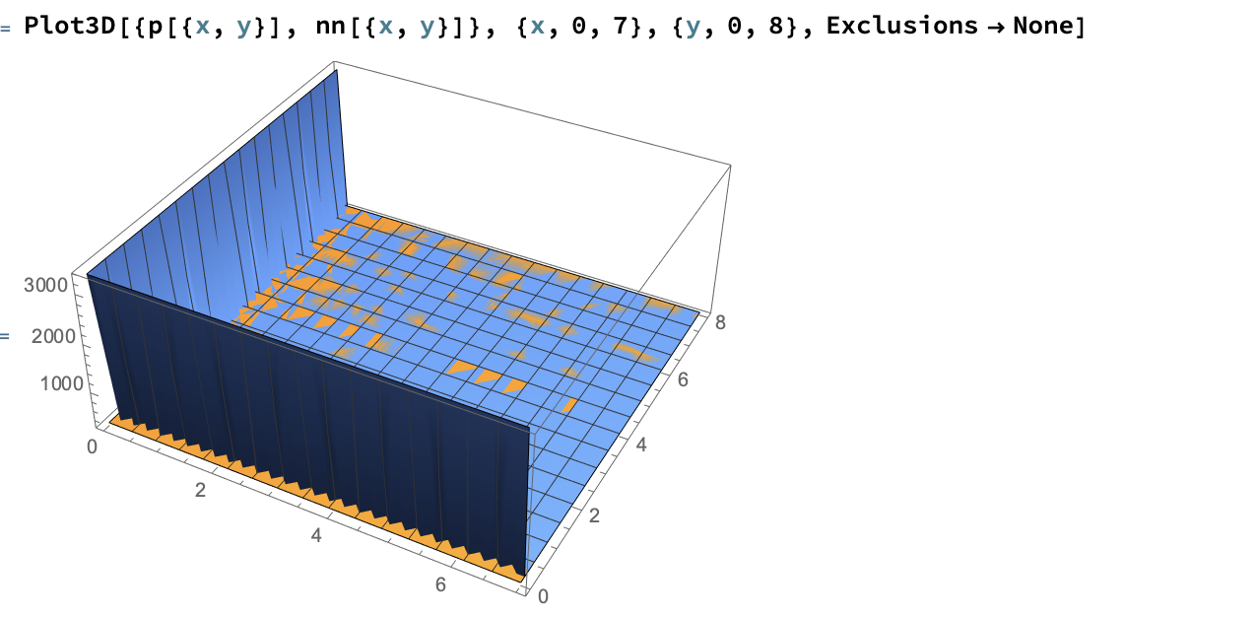
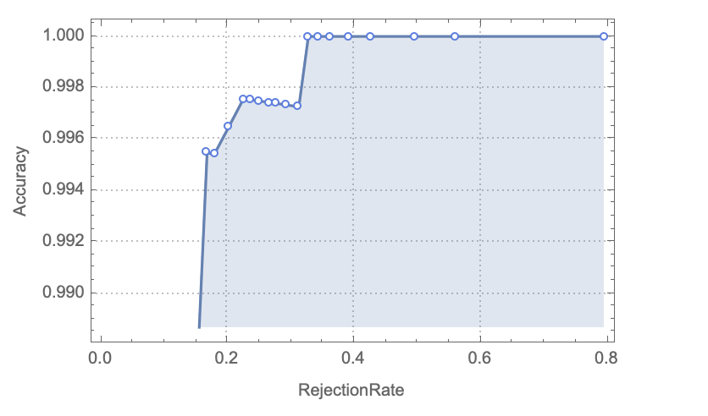
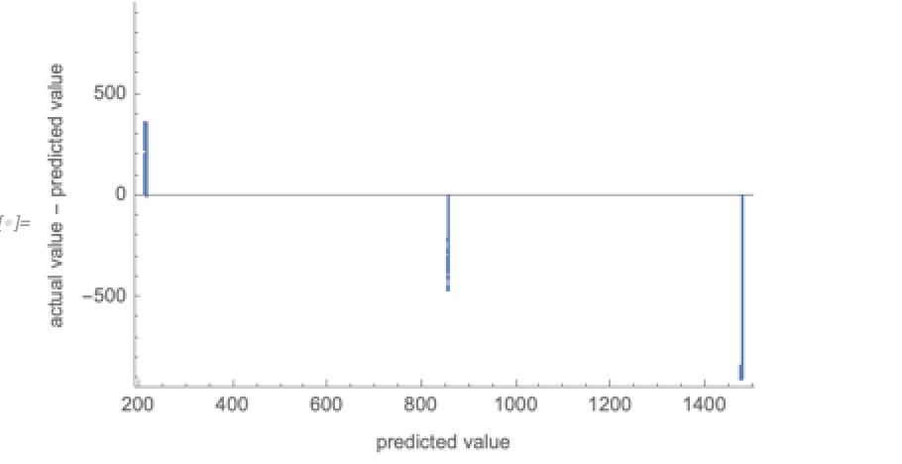
Classification
Prediction
Comparison study of which classifier method would be best for the available transformed dataset.
Dividing the dataset into train and test data by following the standard rule 70%(test data) and 30%(train data) using user defined function.
Comparison study is made on most of classification methods such as NaïveBayes, Logistic regression, NearestNeighbors, RandomForest, SVM.
Comparison study of Accuracy, Rejections rate, Error, PerformanceGoal (TrainingSpeed, Memory) values for each classifier methods.
From the available test and train data different predict methods such as NeuralNetwork, LinearRegression, GaussianProcess, NearestNeighbors, RandomForest used to understand the StandardDeviation, TrainingTime, Memory, TrainingSpeed.
Forcing the train speed to few seconds than default to understand how Standard deviation is varying between default and forced training speed.

